Slide 1
Possession-Based Player Performance Analysis in Basektabll
Yun-Hsiang (Ray) Chan

Slide 2
Introduction
Performance measurement is an important part of basketball game and sports analytics.
Initially, people started building player metrics by linear weights metric using palyer’s box score statistics, such as steals, rebounds, points scored etc.
Then people compute possession-based player performance analyses such as “+/-”, “Net Rating”, or “Adjusted +/-”. PM-based metrics have benefit over purely box score based player maetrics os potentially catching all player actions that have an influence on the outcome of a game.

Slide 3
Traditional Possession-Based Player Metrics
Problem 1. Data is nosiy.
2. Fact that some players are substitute in and out together with one another
Solution
Novel methods such as “Regularized Adjusted +/-” (RAPM) or “4-factor RAPM”.
This chapter lays out the history of development of possession-based player metrics.

Slide 4
10.1 Plus Minus
Definition
The difference between the points his team scores while he is on the court and the points scored by the opposing team during his time on the court.
Concerns
Mediocre or bad players that frequently share cout time with good players can potentially have a strong positive PM. The good player being on the court concurrently will make it more likely that their team outscores the opponent’s team during their time on the court.
Good players on bad teams are likely to have negative PM because of the poor quality of their teammates.

Slide 5
10.2 NET Rating
NET Rating is another PM-based metirc used in conjunction with PM.
Definition
The team’s PM with a player off the court gets subtracted from that player’s PM.
Great palyers will have both positive PM and NET rating.
Problem: great bench players on great teams can have a negative NET simply because they substitute the top players.

Slide 6
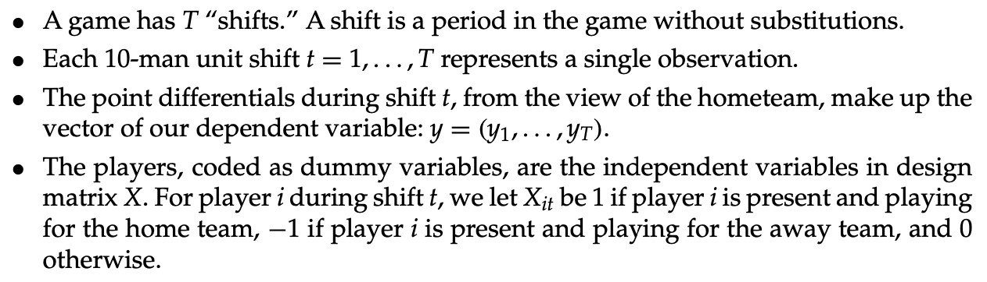
10.3 APM (Adjusted +/-)
Definition
Perform a regression with each player as a binary indicator variable for being on the court, and possession outcomes making up the response vector.
Model:

Slide 7
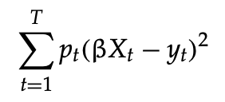
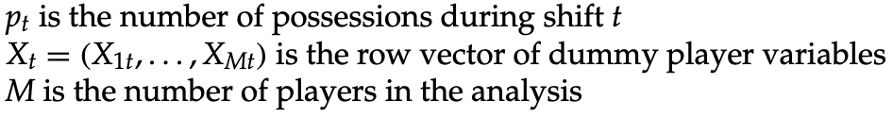

10.3 APM (Adjusted +/-)
When computing APM, we seek the beta that minimizes the expression
where,
The least-squares estimate is given by

Slide 8
10.3 APM (Adjusted +/-)
Problem
The degree of multicollinearity in the data is large, as some players are often substituted in and out simultaneously, or for one another. WIthout any adjustment, OLS is generally ill-suited for problems in which a large degree of multicollinearity exists.
Because the collinearity and that some players compete in very few shits, the coefficient estimates can be quite unstable and unreliable. It’s common to see extraordinary large estimates of beta derived from APM
Solution
One independent variable for players who played less than a certain amount of minutes has been used instead of having one variable per player.

Slide 9




10.3.1 Computing Seperate Estimates for Offense and Defense
Let each possiession represent a single shift
set to 1 if player i in on offense during shift t
, set to 1 if player i is on defense during shift t
horizontally concatenate to create X.
The response variable contains the points scored by the team in possession t of the ball.
The vector of coefficients can be estimated using least-squares regression by

Slide 10
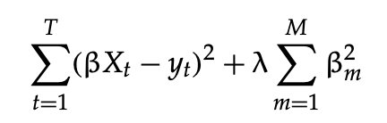

10.3.2 RAPM
Replace OLS with RIdge Regression for computing coefficients.
Objective: minimize
Estimated coefficients:
Advantages
- It is significantly better at predicting out-of-sample data.
- There is no need for using a single dummy variable for all players with less than a cretain amount of miniutes. The regularization will ensure that collinearity is no longer a difficulty, and that these players will not have unreliable estimates.
- With RAPM, both single-seaon and multiple-seasons data lead to stable results.

Slide 11
10.3.3 Potential Additional Variables
Many additional variables can optentially be added to an APM model, such as days rest, control for th influence of coaching.
For multiyear RAPM, player’s age (aging factors, quantitative or dummy) could be added.

Slide 12
10.3.4 Other Applications of the APM Framework
4-Factor RAPM
A similar framework as APM is used to estimate each player’s influence on a team’s four factors (effective field goal percentage, rebounding, turnovers, free throw rate).
Statistical Plus Minus
Performing a regression with each player representing an observation, the player’s stats making up the matrix of predictor variables, and using APM as dependent variable.
Influence on Win Probability
Estimate win probability of the team with the ball, given the current score difference and time left in the game. Use changes in the estimated win probability as dependent variable instead of having “points scored in possession”.

Slide 13
10.4 Implementation
This section describes the data that are necessary to compute
PM
APM
RAPM
4-factor-RAPM
how to transofmer / parse data
how to finally compute estimates using linear regression techniques

Slide 14
10.4.1 Data
To be able to compute any kind of metrics, it is necessary to have play-by-play data, containing
Rebounds (offesnsive, defensive, individual or team rebounds)
Turnovers (including type of turnover)
Shots (type of shot: field goal, free throw, or three-pointer; whether the shot was made or missed; distance)
Player substitutions
For every one of these actions, the play-by-play data provide the names of the players invovled, and a time stamp of the action.
For player’s PM, we need to know who’s on the court.
For (R)APM, we need to know which exact 10 players were on the cout at any given time in the game

Slide 15
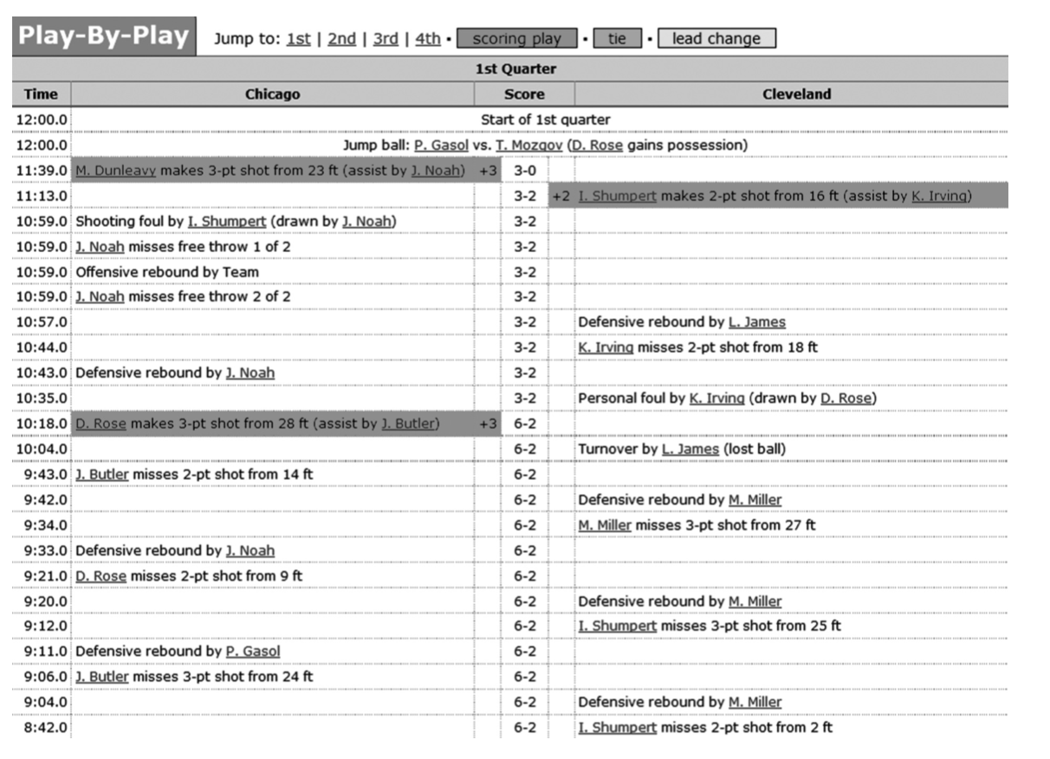
10.4.1 Play-by-Play data

Slide 16
10.4.1 Data
As these metrics try to estimate player influence per possession, we need to parse the play-by-play for “possession-ending” actions. These include
Turnovers
Made field goals with no shooting foul call.
The last of a possible series of free throws, if made
Defensive rebounds

Slide 17
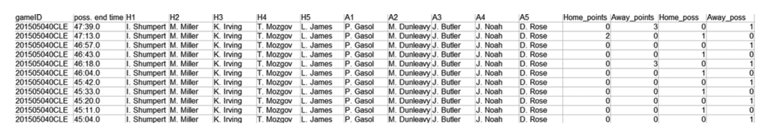
10.4.2 Determing the players are on the court
For (R)APM analysis, it is necessary to determine which 10 players are on the court at any given time in a basektball game.
At the end of each possession, the sum of the points scored in this possesision and which team was in possession of the ball needs to be recorded.

Slide 18
10.4.3 Computing the Different Metrics
10.4.3.1 PM
Def: for every possession that a player is on the court, sum all points scored by his team and subtract points scored by the opponent team.
A player’s total PM will have to be divided by hist total number of possessions played
Note: players from the same team often have similar OM.

Slide 19
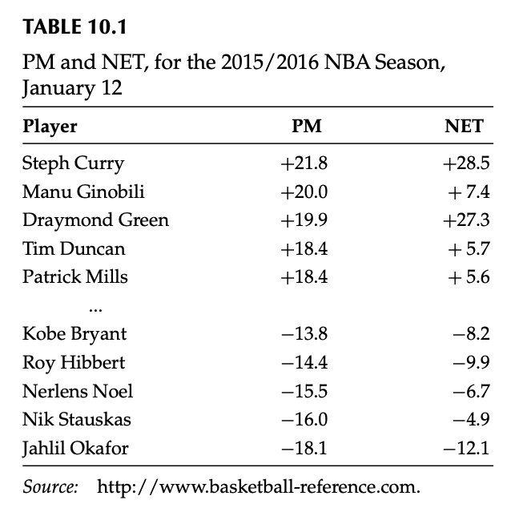
10.4.3.1 PM

Slide 20
10.4.3.2 NET Rating
For computing NET ratings, we need a player’s
raw PM
the team where he has played during the season.
To calculate:
Accumulate the PM of the lineups that did not include him (OFF Rating)
Subtract OFF Rating from his PM to get his NET Rating.

Slide 21
10.4.3.3 APM
The calculation of APM requires regression analysis.
Need: softawre that is able to work with sparse matrices (MATLAB, R, Python)
Design Matrix X: rows are indexed by observations and columns that correspond to individual player dummy variable
Observation: every possession in a basketball results (roughly 190 per game)

Slide 22
10.4.3.3 APM
Columns:
To compute both offensive and defensive ratings, the number of columns in the design matrix is twice the number of players in the league.
In most NBA seasons, there are approximately 250,800 possessions and 500 players, so the design matrix need 250,000 * 1000 for one NBA season.
In each row, exactly 10 entires are nonzero value.

Slide 23

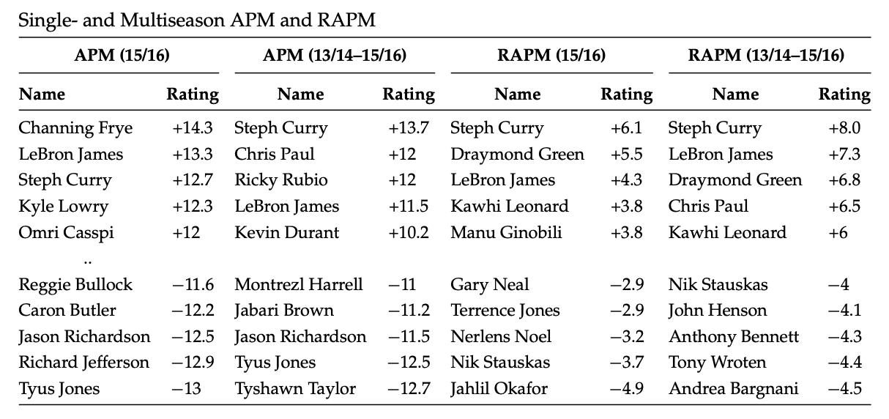
10.4.3 APM
With this design matrix and response vector, we are now able to compute regression coefficients. We can use scikit-learn
The results are:

Slide 24

10.4.3 APM
For computing RAPM estimates, we can use the exact same design matrix and response vector, but we need to call a different regression function.

Slide 25
10.5 Outlook
PM-based metrics currently represent the most accurate publicly available metrics, with those metrics that consist of, or are informed by an SPM prior, performing slightly better than their pure PM counterparts.
The APM framework itself can further be modified to find the impact players have on their teammates’ box score statistics, which can lead to more accurate estimates of what a player’s box score statistics would be on “average team”.
Player impact on changes in win probability need to be further studied, and its prediction accuracy needs to be compared to that of RAPM.

Slide 26
Potential Direction
I’m personally interested in fitting such a model for player’s impact on his team’s shooting performance (for the %, and maybe the number of attempts). Not only using the stats that whether player is on the court or not, I also want to add the the numbers of attempts and made shoots by player on each possession and see the impact of those.
I might wanna to start this before reading week (start by cleaning the data, which should be pretty complex lol).
Another interesting paper is using estimating an NBA player’s impact on proability of winning. I will read this one on my spare time and see can I get any inspiration from that. The paper is also provided in the drive.

